Slide 1

DRUGS IN DENTISTRY BUSHRA IMDAD (M.PHILL Fellow) INSTRUCTOR SDCP, DUHS

Slide 2
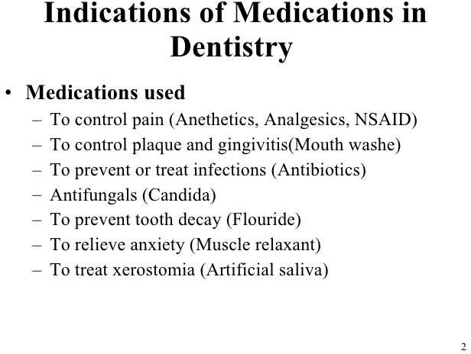

Slide 3
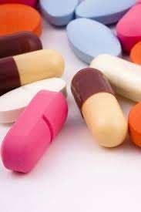
Antibiotic
Use only when there is an indication :
Choose the narrowest spectrum drug that will be
effective Consider the risk/benefit equation
Prescribe an adequate dose
Adequate frequency
Adequate duration

Slide 4
INDICATION FOR THE USE OF ANTIBIOTICS IN DENTISTRY
Oral infection accompanied by elevated body temperature
Evidence of systemic spread
Facial cellulitis and/or dysphagia
Periodontal abscess
ANUG
Sinusitis
Pericoronitis

Slide 5
NON-INDICATION FOR THE USE OF ANTIBIOTICS IN DENTISTRY
Acute Periapical infection
Dry Socket
Acute Pulpitis
Chronic Marginal Gingivitis
Chronic Periodontitis

Slide 6
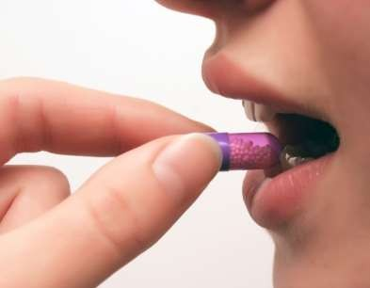
Reasons for Failure of antibiotic
Wrong drug or dose
Bacterial resistance
Host defenses depressed
Poor compliance

Slide 7
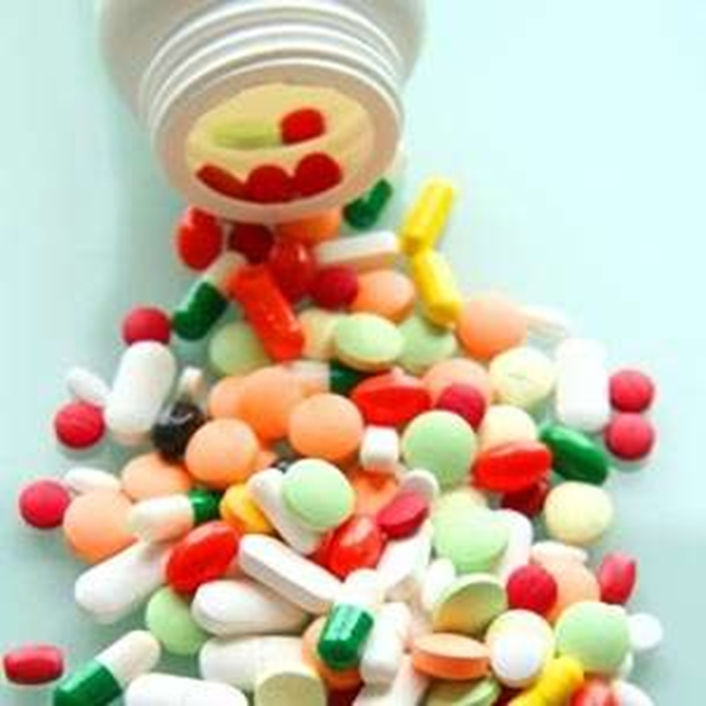
Antibiotic actions
Bactericidal Penicillins Metronidazole Cephalosporins Aminoglycosides Vancomycin
Bacteriostatic Clindamycin Erythromycin Tetracyclines

Slide 8
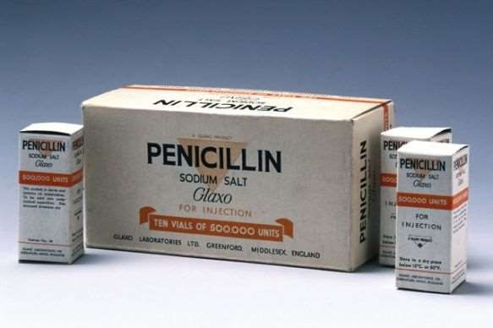
Penicillin
Oral penicillin are penicillin V and amoxicillin
Pen V is narrow-spectrum against gram-positive Strep and others
Drug of choice for orofacial infections
Dose = 300-600 mg q6h
Amoxicillin is broad-spectrum and better absorbed orally Dose = 250-500 mg q8h
Dental uses
dental abscesses, infections around wisdom teeth and infections after surgery

Slide 9
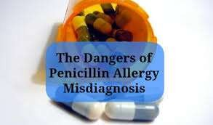
Adverse reactions of penicillin
Allergy
Diarrhea
Nausea and vomiting
Pseudo membranous colitis Candidacies
Allergy rate is 1-10% of the population
Penicillin responsible for 75% of anaphylaxis deaths

Slide 10
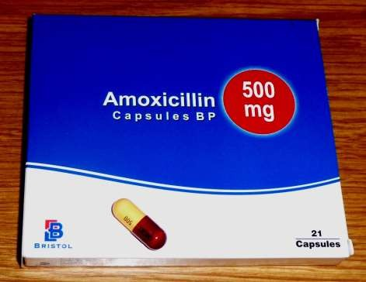
Amoxicillin
Indications
Used to treat bacterial infection such as a dental abscess. Used prophylactically in the prevention of infective endocarditis
Contraindications
Hypersensitivity.
Precautions
Renal disease.
fever

Slide 11

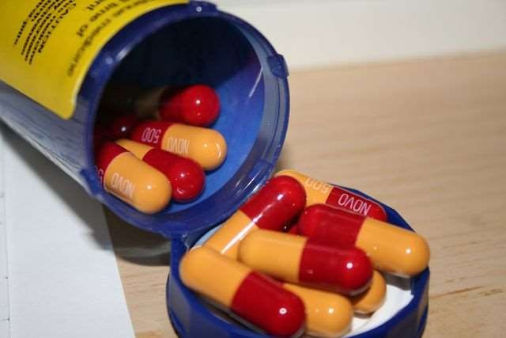
Side effect
Glossitis and tongue discolouration.
Candidiasis.
Hypersensitivity.
Gastrointestinal upset.
Pseudomembranous colitis.
Hypokalemia

Slide 12
Cephalosporin
Indications
Used to treat bacterial infection (Second Choice) less effect foe anaerobes.
More resistance to penicillinase

Slide 13
Side Effects
*Cephalosporins are bactericidal agents (which means that they kill bacteria)
mild stomach cramps or upset, nausea, vomiting, and diarrhea. Cephalosporins can also cause overgrowth of fungus normally present in the body.
Cross allergy with penicillins
Because the cephalosporins are structurally similar to the penicillins, some patients allergic to penicillins may be allergic to a cephalosporin antibiotic.

Slide 14
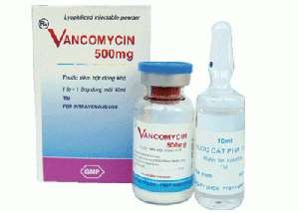
Vancomycin
antibiotic useful for the treatment of a number
of bacterial infections. It is of the glycopeptide antibiotic class and is effective mostly against Gram-positive bacteria.
* treatment of penicillin-resistant Staphylococcus aureus
Vancomycin should be reserved for a condition that
does not respond to metronidazole
Side effects
IV vancomycin include: local pain
nephrotoxic and ototoxic drug
Vancomycin should be reserved for a condition that does not respond to metronidazole

Slide 15
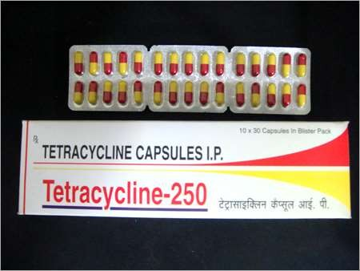
Tetracycline
Group includes tetracycline, doxycycline (Vibramycin, Periostat) and minocycline (Minocin)
Broad-spectrum, bacteriostatic
Useful in treatment of periodontal disease Widespread resistance
Host of adverse effects including: tooth staining, photosensitivity, blood dyscrasias, GI effects

Slide 16
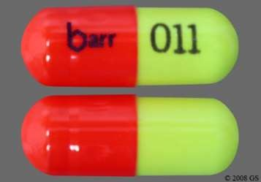
Tetracycline
Contraindications:
Renally impaired patients should not be treated with any of the tetracyclines except doxycycline
The tetracyclines should not be employed in pregnant or breast-feeding women or in children less than 8 years of age.

Slide 17
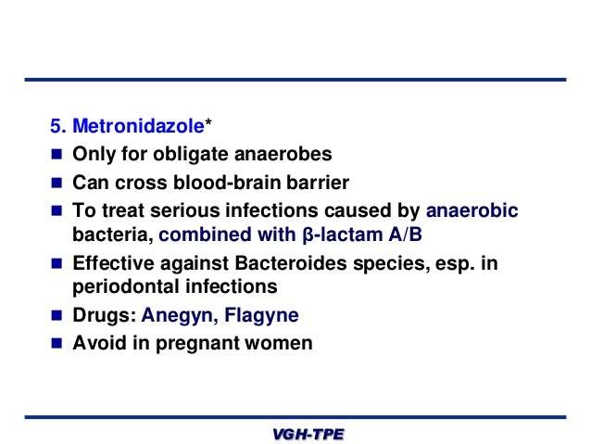
Metronidazole

Slide 18
Antibiotic adverse reaction
Overall incidence is 6-7% Possible reactions include:
GI tract complications Colonization of resistant or fungal strains Cross reactions with other medications
Pseudomembranous colitis Development of resistant bacteria and superinfection Little concern about short-term use

Slide 19
May be indicated for patients at increased risk including:
< 2 years post-surgery
Inflammatory joint disease
Immunosuppressant (incl. drug-induced, radiation-induced, HIV)
Previous joint infections Type I diabetes mellitus
Hemophilia
Malignancy

Slide 20
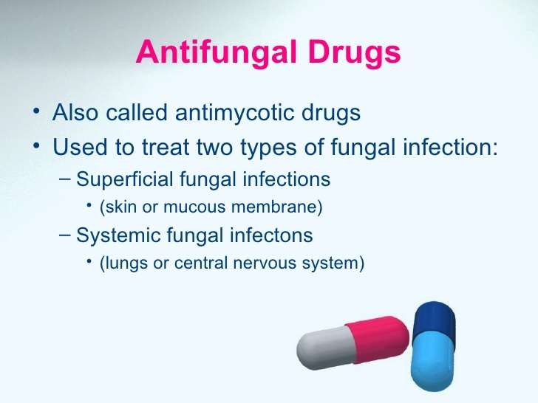

Slide 21
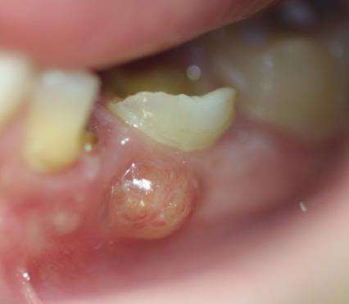
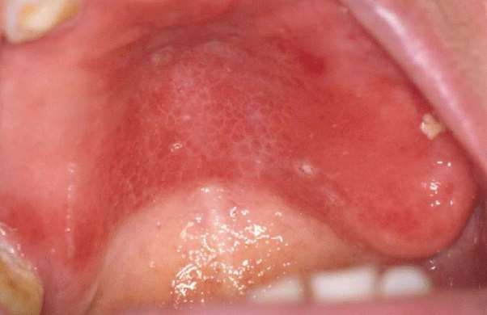
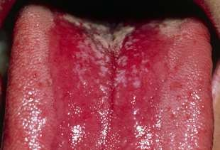
Indication of antifungal drugs
-Stop spread of infection
-Treat oral thrush
-Denture stomatitis
-Used in combination with antibiotic in case of abscess

Slide 22
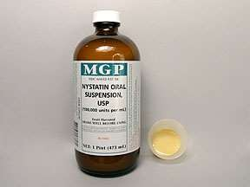
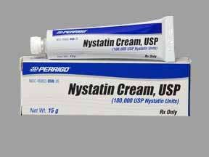
Nystatin(nystan)
Indications
Used in the treatment of candidal infections
Contraindications
Hypersensitivity.
Side effects
Hypersensitivity. Gastrointestinal upset

Slide 23
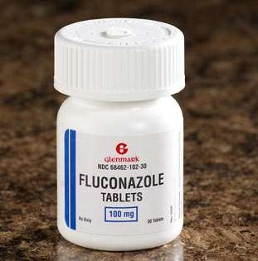
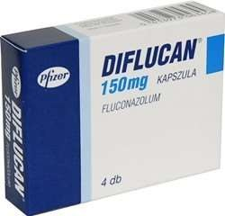
Fluconazole (diflucan)
Description
Diazole antifungal agent.
Indications
Used to treat oral fungal infections

Slide 24
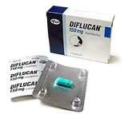
Fluconazole
Contraindications
Previous hypersensitivity
Best avoided during pregnancy and when breastfeeding.
Precautions
Use with caution in patients with renal and hepatic disease.
Side effects
Hypersensitivity reactions. Gastrointestinal problems

Slide 25
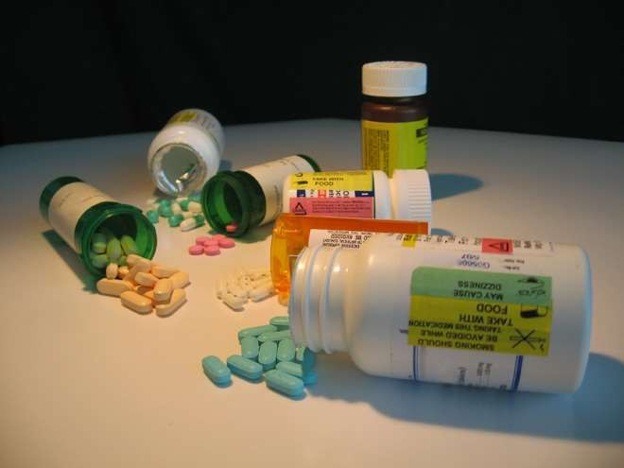
Antiviral drugs
Treatment of viral infections has posed the greatest problem of all infectious organisms Viruses are obligate intracellular organisms
The herpes virus is of the most interest to the dental health care worker

Slide 26
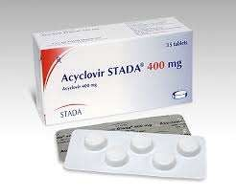
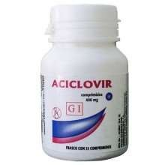
Acyclovir (Zovirax)
Indication
Used in topical , IV, oral formulations
Herpes simplex virus 1,2 (HSV)
Varicella zoster virus And used in treatment of herpes simplex

Slide 27

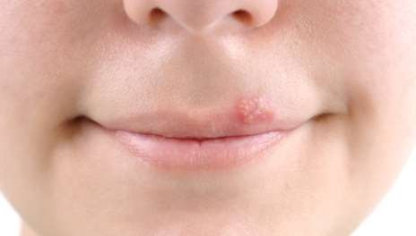
Herpes Simplex
Herpes viruses are associated with “cold sores”
Most antiviral agents are either purine or pyramiding analogues that inhibit deoxyribonucleic acid (DNA) synthesis

Slide 28
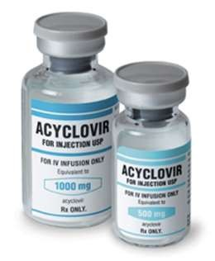
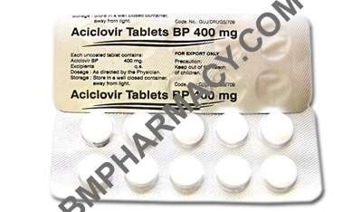
Adverse reactions
Topical administration: produces burning, stinging, or mild pain in about one third of patients
Oral administration: headache (13%) is one of the most common; other central nervous system (CNS) and GI effects
Parenteral administration: local reactions at the injection site are the most common

Slide 29
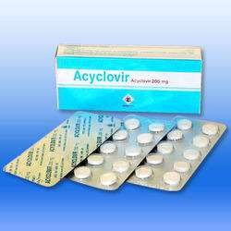
Side effect of acyclovir
-Firm sensation at site of application, altered taste, gastrointestinal upset, renal failure, bone marrow depression, tremors and convulsions, lichenoid reactions, rash and urticaria

Slide 30
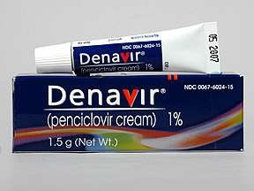
Penciclovir
Available topically Shown to reduce both the duration of the lesion and the pain of the lesions on the lips and face associated with both primary and recurrent herpes

Slide 31
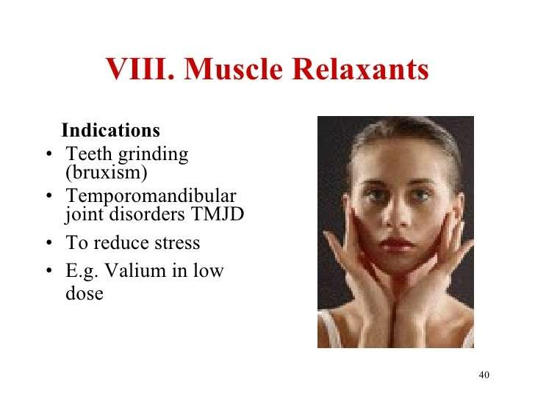
Muscle relaxant

Slide 32
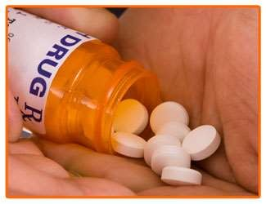
Diazepam(Valium)
Description
A benzodiazepine sedative and anxiolytic drug with anticonvulsant
properties.
Indications
Used in dental sedation and preoperative anxiolysis (although it has now been superseded by midazolam when intravenous techniques are employed: for oral sedation temazepam is the drug of choice).
Also indicated in the emergency treatment of epilepsy in the dental surgery.

Slide 33
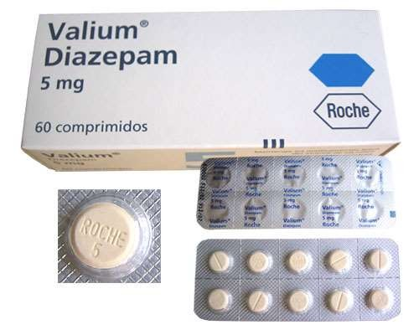
Contraindication
Severe respiratory disease. Severe liver disease.
Porphyria (although should be used in emergency management of status epilepticus).
Precautions
History of drug abuse.
Severe liver disease.
Severe muscle weakness (myasthenia gravis). Pregnancy and breastfeeding.
Unwanted effects
Xerostomia. Respiratory depression. Hypotension.
Visual disturbances

Slide 34
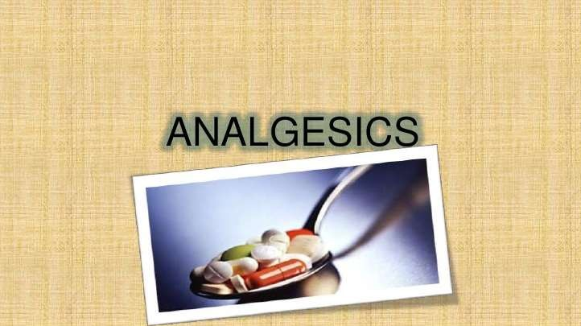

Slide 35
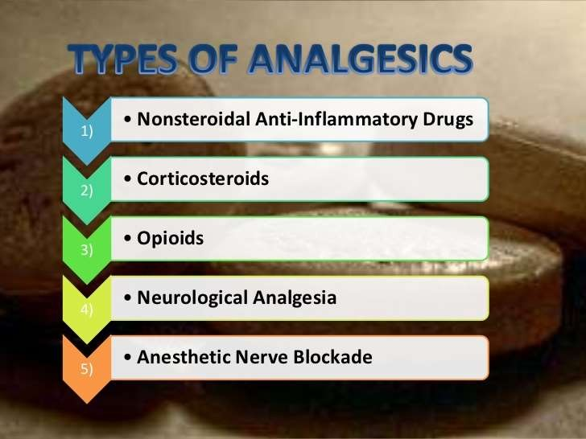

Slide 36
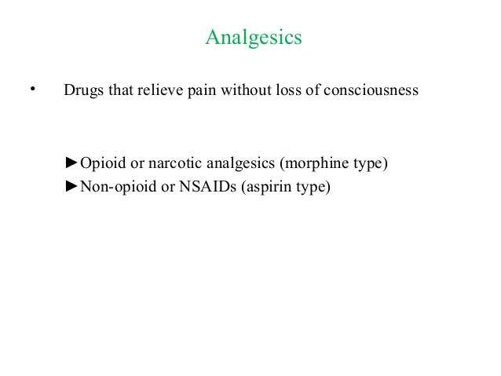
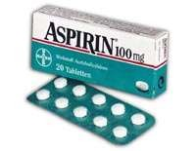
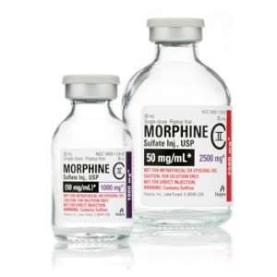
Analgesic

Slide 37
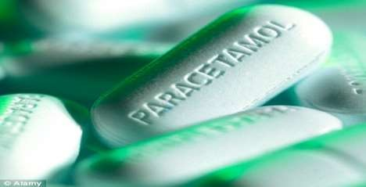
Adverse effects
The most important toxic effect is hepatic necrosis leading to liver failure after overdose, but renal failure in the absence of liver failure has also been reported after overdose.
There is no convincing evidence that paracetamol causes chronic liver disease when used regularly in therapeutic doses (4 g/24 hours). Paracetamol is structurally closely related to phenacetin

Slide 38
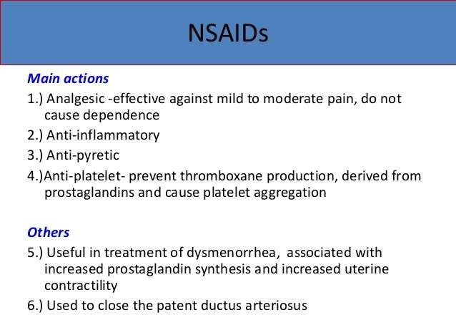

Slide 39
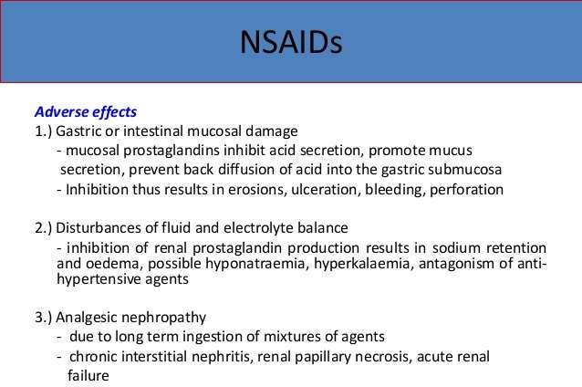

Slide 40
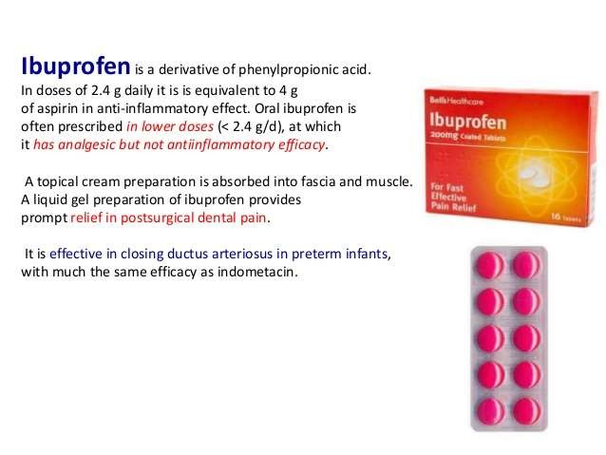
Ibuprofen

Slide 41
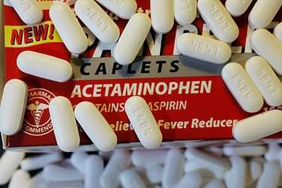
Acetaminophen
Indications
Pain and inflammation associated with musculoskeletal disorders,
e.g. rheumatoid arthritis, osteoarthritis, and ankylosing spondylitis, Postoperative analgesia.
Effects on oral and dental
Patients on long-term NSAIDs such as acemetacin may be afforded some degree of protection against periodontal breakdown. This arises from the drug’s inhibitory action on prostaglandin synthesis.

Slide 42
NSAID contraindications
Gastric ulcers
Bleeding dyscrasias or concerns
Significant renal disease (or other NSAID) hypersensitivity
Combination of severe asthma, nasal polyps and multiple allergies Can lead to ARDS
Pregnancy:
Especially in the 3rd trimester

Slide 43
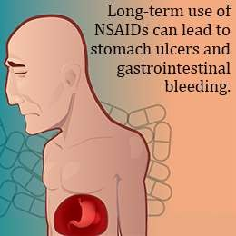
NSAID Adverse Effects
Increased bleeding
Gastric mucosal damage
Dyspepsia
Nephrotoxicity
Anaphylactoid reactions

Slide 44
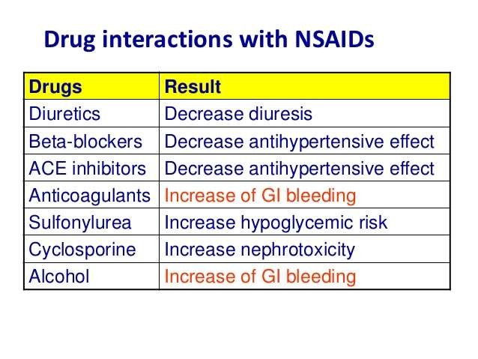

Slide 45
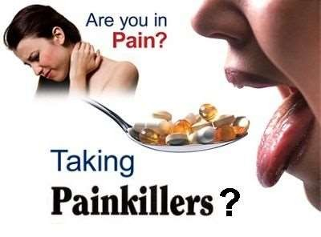

Slide 46

Thank you

